Slide 1

Weekly Task
HTML , CSS & Responsive Website

Slide 2
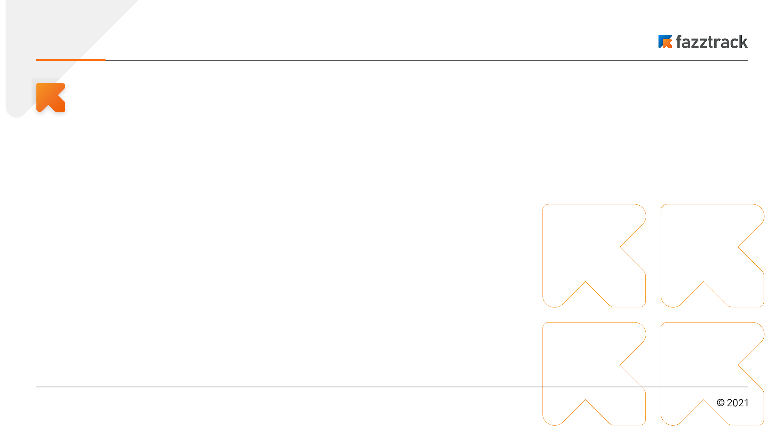
Weekly Task
There are several things we need to know when create a web page:
HTML
HTML or HyperText Markup Language, provides a set of tags or elements that define the structure and layout of a web page such as headings, paragraphs, images, forms etc.
CSS
CSS or Cascading Style Sheets is used for styling and layouting a web page and works in conjunction with HTML to create visually appealing and responsive web design.
Responsive Web
An approach to web development to build websites that adapt and respond well across a wide range of devices and screen sizes, including desktops, laptops, tablets, and smartphones.
Backend devops

Slide 3
Demo Project

